Slide 1
WIEGMANN
NEMA 101 Training
June 4th, 2020
Travis Miller

Slide 2
AGENDA
What is NEMA
What Are the Different NEMA Enclosure Types
What NEMA Types Does WIEGMANN Offer
Other Products
Other Standards

Slide 3
What Is NEMA
National Electrical Manufacturers Association
Purpose Is To Improve The State Of Electrical Manufacturing In The United States.
350 Member companies
Publishes 700+

Slide 4
What Is NEMA
NEMA Enclosure Types
NEMA defines standards used in North America for various grades of electrical enclosures typically used in industrial applications. Each is rated to protect against personal access to hazardous parts, and additional type-dependent designated environmental conditions. A typical NEMA enclosure might be rated to provide protection against environmental hazards such as water, dust, oil, coolant, or atmospheres containing corrosive agents.

Slide 5
NEMA Enclosure Types
Type 1
Type 2
Type 3
Type 3R/X
Type 3S
Type 4
Type 4X
Type 5
Type 6
Type 6P
Type 12/K
Type 13

Slide 6
WIEGMANN / NEMA
Type 1
Type 2
Type 3
Type 3R/X
Type 3S
Type 4
Type 4X
Type 5
Type 6
Type 6P
Type 12/K
Type 13

Slide 7
WIEGMANN / NEMA
Type 1
Type 2
Type 3
Type 3R/X
Type 3S*
Type 4
Type 4X
Type 5
Type 6
Type 6P*
Type 12/K
Type 13
* Type 3S and 6P are only available in Non-Metallic

Slide 8
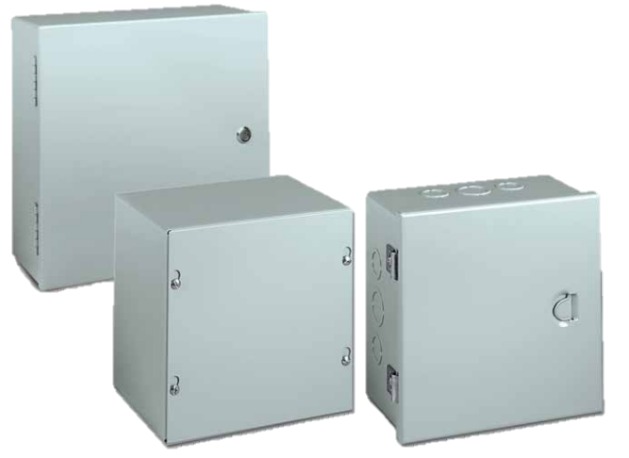
NEMA 1
Indoor Use
Protects user from contact.
Protects components from:
Ingress of solid objects
Falling dirt
Designated by “SC” “A” “N1C”
S

Slide 9
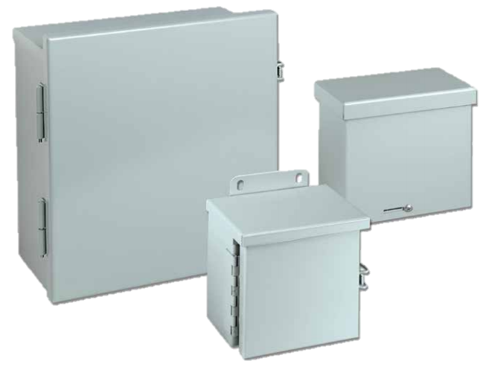
NEMA 3RX
Indoor or Outdoor Use
Protects user from contact.
Protects components from:
Ingress of solid objects
Falling dirt
Dripping/light splashing water
Designated by “RSC” “RHC” “LOH” “WCT” “CT”

Slide 10
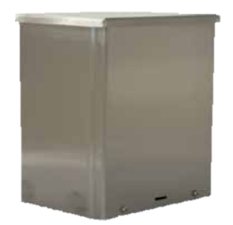
NEMA 3RX
Indoor or Outdoor Use
Protects user from contact.
Protects components from:
Ingress of solid objects
Falling dirt
Dripping/light splashing water
X – signifies corrosion protection
Designated by “RSC_NKSS”
S

Slide 11
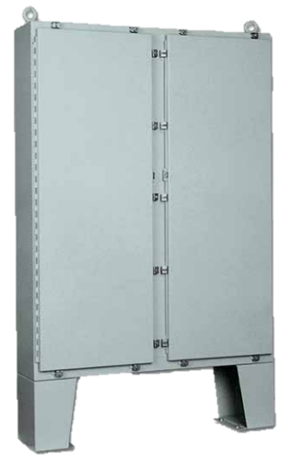
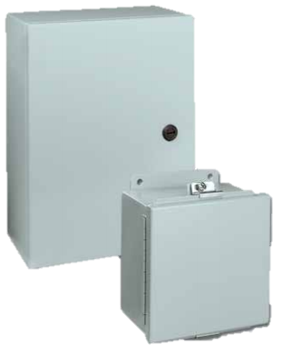
NEMA 4
Indoor or Outdoor Use
Protects user from contact.
Protects components from:
Ingress of solid objects
Windblown dust, rain, sleet, snow
Hose directed Water
Undamaged by ice forming on the surface
Designated by “BN4” “Ultimate” “WA_GSC” “N412_C” “N4” “WRD”

Slide 12
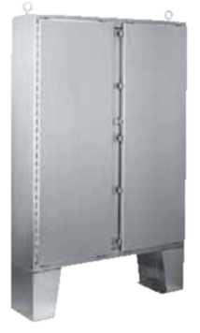
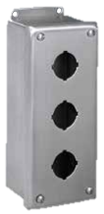
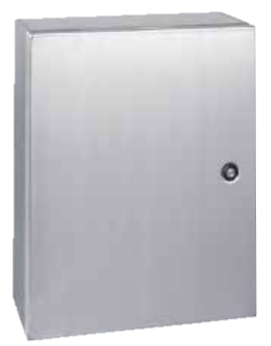
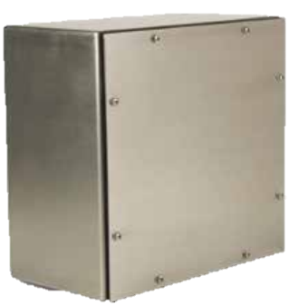
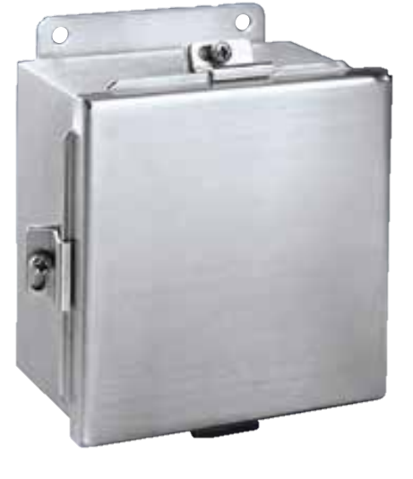
NEMA 4X
Indoor or Outdoor Use
Protects user from contact.
Protects components from:
Ingress of solid objects
Windblown dust, rain, sleet, snow
Hose directed Water
Undamaged by ice forming on the surface
X – signifies corrosion protection
Designated by “BN4” “WA_GSC” “N412_C” with “SS” “SSA” or “AL” at the end

Slide 13
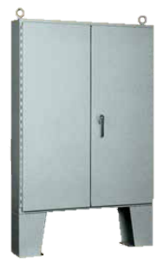
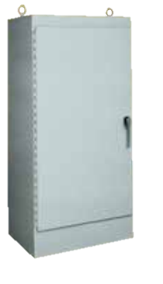
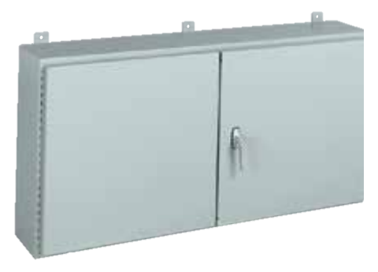
NEMA 12
Indoor Use
Protects user from contact.
Protects components from:
Ingress of solid objects
Windblown dust, rain, sleet, snow
Oil and Coolant Seepage
Designated by “B_/CH” “N12” “WA_WF/FS/FSD/FSDA/FSDAD/E”

Slide 14
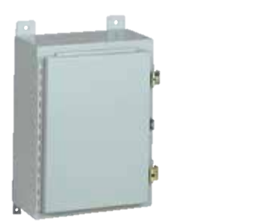
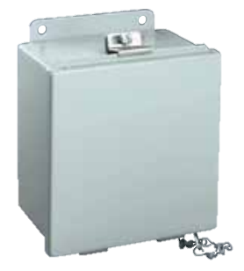
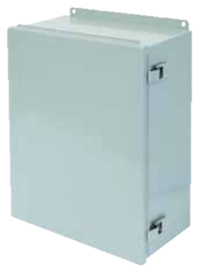
NEMA 13
Indoor Use
Protects user from contact.
Protects components from:
Ingress of solid objects
Windblown dust, rain, sleet, snow
Oil and Coolant Seepage
Oil and Coolant Spay/Splash
Designated by “B_/CH/CHQR/SC/CHFTC” “WA_GIE” “WA_FM” “N12”

Slide 15
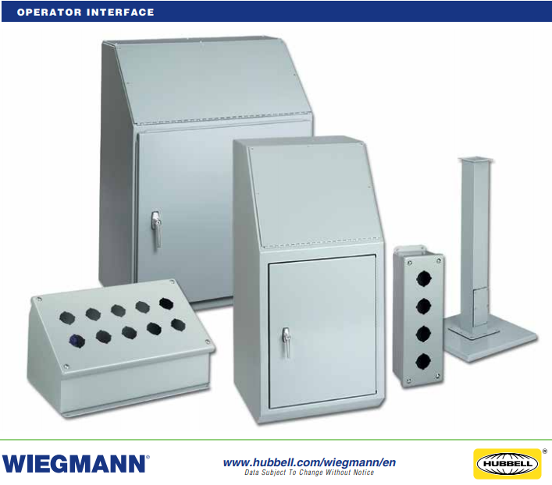
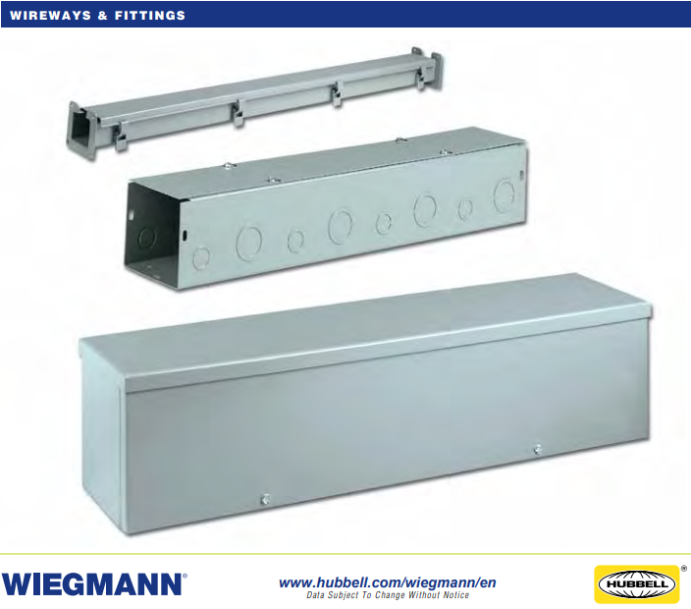
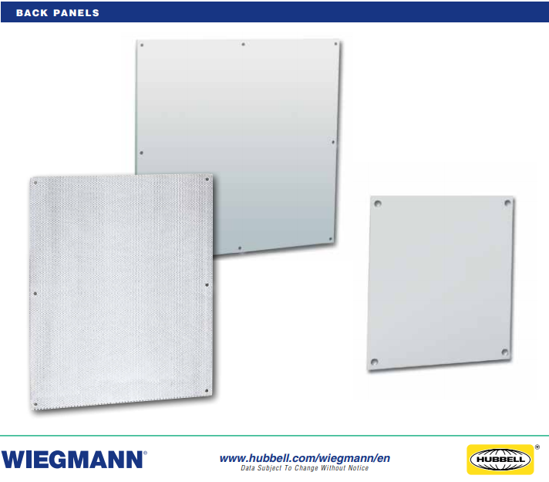
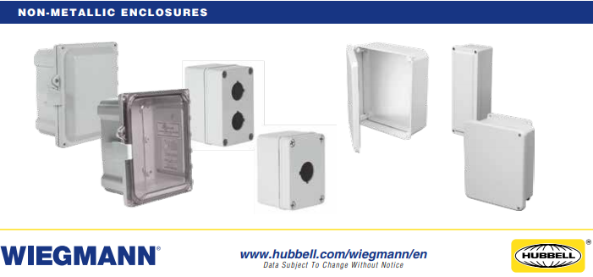
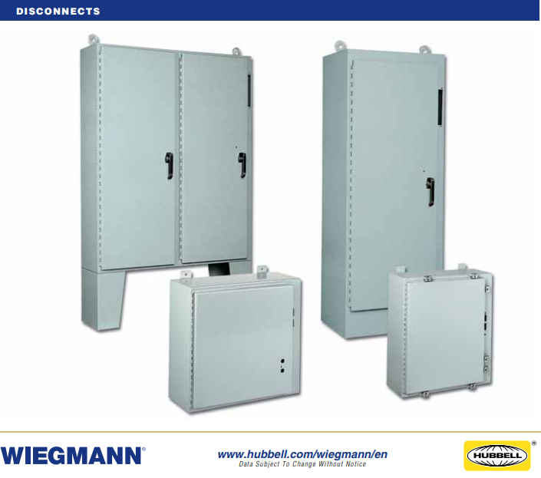
Other Products
Wireway / Fittings/ Troughs
Non-Metallic
Back Panels
Disconnects

Slide 16
NEMA Summary

Slide 17
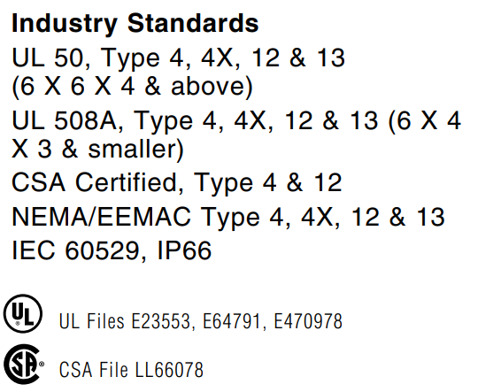
Additional Standards
Some Products Meet Multiple NEMA Ratings
Other National And International Standards May Also Apply

Slide 18
NEMA vs IEC
IEC is the primary stand used in Europe

Slide 19
QUESTIONS?

